Slide 1
Anti-LGBTQ Laws in Uganda
Tristan Lovestrand
THEO 203

Slide 2
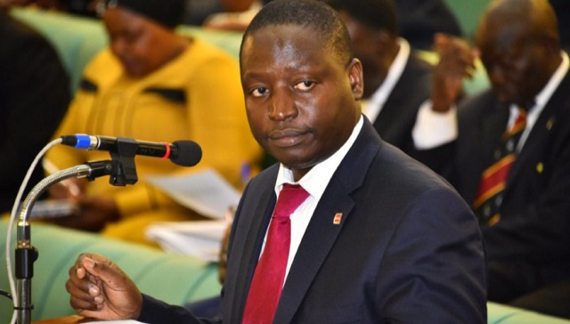
Uganda’s History of Anti-LGBTQ Legislation
In October of 2009, a Ugandan legislator named David Bahiti proposed the country’s first “Anti-Homosexuality Bill” in Uganda’s Parliament.
Interestingly, the Western world acted in outrage and were baffled by the egregious intolerance of homosexuality seen on full display by Uganda.
The contents of this bill, which was eventually passed in 2014, essentially detailed that those “found guilty of engaging in same-sex relationships faced the death penalty.” (Seo, 46)
-David Bahiti, 2009

Slide 3
Uganda’s History of Anti-LGBTQ Legislation (cont.)
As a result, the Western world, specifically it’s media, began to stereotype Uganda, and eventually all of Africa. They called them backwards, uncivilized, and helpless among various other generalizations.
Coincidentally, the media (blogs, posts, news, etc.) seemingly neglected to add that much of Uganda’s anti-LGBTQ rhetoric had been directly influenced by the Western world’s own atmosphere of homophobia, transphobia, etc.
What group in the Western world could have possibly influenced Uganda’s wildly homophobic legislation? Western evangelical and political groups (More on that later…)

Slide 4
Africa’s History with Anti-LGBTQ Rhetoric
Although the Western public was given a rather myopic depiction of Uganda’s anti-LGBTQ legislation and culture, Uganda is a country that is heavily connected with blatant homophobia/transphobia in our current day & age.
However, Uganda’s anti-LGBTQ rhetoric is complex and full of nuance in its origin. As author Hyeon-Jae Seo writes, “the widespread homophobia in Uganda is a complex labyrinth of historical remnants, foreign influences, socioeconomic obstacles, and political manipulations that form a rather dangerous environment for homosexuals.” (Seo, 46)
In short, African culture has not necessarily always been anti-LGBTQ.

Slide 5
Africa’s History with Anti-LGBTQ Rhetoric (cont.)
It may sound surprising, but one does not need to look that far to find evidence that refutes African political leaders’ claims that homosexuality is “antithetical to traditional African culture and that attacks on gay relationships are tantamount to upholding traditional values.” (Seo, 46)
There have been numerous studies conducted on precolonial African groups which demonstrate that openly gay/homosexual relationships were traditionally practiced throughout the continent.
  These studies include (but are not limited to):
    Marc Epprecht’s 2008 study of the San people in Guruve, Zimbabwe
    E.E. Evans Pritchard’s 1970 study of the Azande in Central Africa
    John Faupel’s 1962 study of the Ugandan kingdom of Buganda (Seo, 46)

Slide 6
The West’s Transnational Homophobia Influence
These studies provide evidence showing that while same-sex relationships were nonconforming and even frowned upon at times, they were not considered illegal and certainly were not considered to be criminal offenses...yet.
It was not until the influence of Western imperialism on Africa (specifically Western evangelical & political influences) when same-sex relationships eventually became criminalized and simply being openly gay could result in the loss of one’s life.
Western imperialism introduced Africa to state sanctioned homophobia. This took shape in the form of religious, anti-LGBTQ laws. Additionally, since West colonialists perceived Africa and its people as primitive, they essentially made heterosexuality the “natural” sexual orientation of the continent, dubbing Africa to a be a “heterosexual continent.” (Seo, 46)

Slide 7
The West’s Transnational Homophobia Influence (cont.)
From here on out, various African leaders and politicians throughout history (such as the aforementioned David Bahiti) began to idealize heterosexuality as the “normal” sexual orientation and a staple of African tradition.
Alongside the growing sentiment of gradually turning Africa into a exclusively heterosexual continent, African leaders (in addition to their Western influencers) began to overtly condemn homosexuality, describing it as a toxic social construct that was unjustifiably imposed & forced upon African populations.
As the culture of extreme homophobia becomes more entrenched in African tradition, government leaders are able to “rationalize” and “justify” the violent anti-LGBTQ policies they implement into their country by saying they are appealing to cultural beliefs and African tradition.

Slide 8
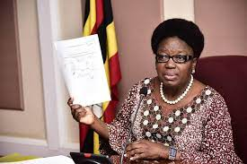
Example: Ugandan Speaker of Parliament
“When Canadian Foreign Minister John Baird confronted Ugandan Speaker of Parliament Rebecca Kadaga about Uganda’s treatment of sexual rights, she claimed that Uganda had the right to make their own laws to protect traditional and cultural values, then promised to pass the anti-LGBTQ bill as a gift to Ugandans. Her reaction is indicative of how the idea that homosexuality is “un-African” is caught in a cycle of self-reinforcement in the minds of Ugandans” (Seo, 46)
-Rebecca Kadaga

Slide 9
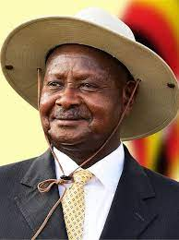
Modern Ugandan Anti-LGBTQ Legislation
On May 29th, 2023, the Ugandan President Yoweri Museveni passed a new anti-LGBTQ law that, in short, “puts the country’s already persecuted LGBTQ+ community at risk of life imprisonment for same-sex relations and calls for the death penalty for ‘aggravated homosexuality.’” (Sanderson, 2023)
  What does the law mean by “aggravated homosexuality?”
“Uganda’s Leader Signs into Law Anti-Gay Bill”
-current Ugandan President, Yoweri Museveni

Slide 10
Modern Ugandan Anti-LGBTQ Legislation (cont.)
This is a very draconian legislation that carries a fearsome, giant risk for Ugandans who identify with the LGBTQ community. Additionally, it is a massive blow to fundamental human rights in the country. The legislation essentially makes it so LGBTQ identifying people almost literally cannot express themselves unless they want to the risk of being thrown behind bars for life or straight put to death.
However, just like the previous examples of African anti-LGBTQ rhetoric, the modern day Ugandan anti-LGBTQ rhetoric is also rooted in Western evangelical, religious institutional influence.

Slide 11
Evangelical Exportation of Anti-LGBTQ Culture Wars
When the US government started legalizing gay marriage at the state level back in the 2000s, lots of radical evangelical communities began realizing that they were fighting a losing battle in making homosexuality illegal here in the US. As a result, they alternatively turned their focus to Uganda, “which was seen as fertile ground for this anti-gay ideology due to a majority conservative Christian base and young population.” (Sanderson, 2023)
  Additionally, Uganda was at a drastic national “low” at the time, as they were still recovering from a devastating civil war during the 1980s and had been significantly impacted by the HIV/AIDS crisis during the 1990s. All this became fuel for anti-LGBTQ rhetoric which would eventually transform into various homophobic policies. (Sanderson, 2023)

Slide 12
Evangelical Exportation of Anti-LGBTQ Culture Wars (cont.)
Since then, American evangelical organizations have spent several years and tens of millions of dollars in an attempt to spread their homophobic agenda to Uganda (and beyond).
  “Data from OpenDemocracy shows that from 2007 to 2020, over 20 US evangelical groups spent at least $54 million in Africa ‘to influence laws, policies, and public opinion against sexual and reproductive rights.’ Nearly half of that figure was spent in Uganda.” (Sanderson, 2023)
The evangelical movement to spread their homophobic ideology to other countries gained traction in 2009 after a three-day conference held in Kampala (capital of Uganda) headlined by three popular American evangelical leaders. The focus of the conference was to encourage Ugandans to “expose the homosexuals’ agenda.” (Sanderson, 2023)

Slide 13
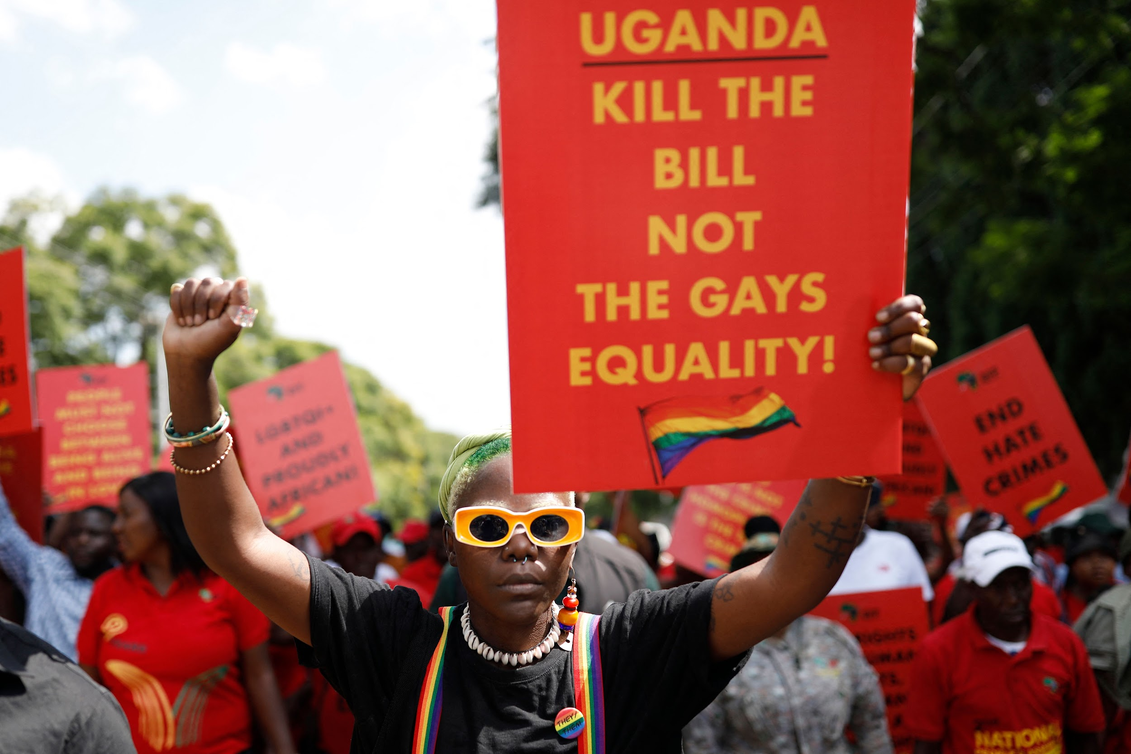
Evangelical Exportation of Anti-LGBTQ Culture Wars (cont.)
American evangelical speakers promoted the idea that the “traditional” family in Uganda was a heterosexual family, and that the traditional sexual orientation in Uganda was heterosexuality. They further claimed the LGBTQ Westerners and activists were attempting to spread their “homosexual agenda” by recruiting & corrupting Ugandan children and young people around the world.
Shortly after this 2009 seminar, the previously mentioned David Bahiti quickly wrote the rough draft version of the Anti-Homosexuality Act, which was eventually passed in 2014.
  However, this extremely homophobic bill caught the ire of other countries, including the US, and led some countries’ governments to withhold aid from Uganda.
  Additionally, there are Ugandan pro-LGBTQ activist groups that are frequently protesting in the streets and making their voices heard that they (Ugandan government) should kill the 2023 bill, not the gays’ equality.
-pro-LGBTQ activist protest in Uganda

Slide 14
Q & A
Does the Ugandan persecution of the LGBTQ community resemble other historic examples of generalized, discriminatory persecution against the marginalized? How so?
Knowing that the Western world, specifically the US, has massive influence on Uganda’s extreme anti-LGBTQ legislation, what can we do on a macro and/or micro level to challenge the spread of anti-LGBTQ rhetoric?
Given the context of the United States’ influence on Uganda’s anti-LGBTQ rhetoric, how do you view our country’s current stance on LGBTQ related matters? Do you find any similarities between America and Uganda in this respect? Differences?
Are there any reactions/thoughts exclusive to the previous couple questions?

Slide 15
References
SEO, HYEON-JAE. “ORIGINS AND CONSEQUENCES OF UGANDA’S BRUTAL HOMOPHOBIA.” Harvard International Review, vol. 38, no. 3, 2017, pp. 44–47. JSTOR, https://www.jstor.org/stable/26528682. Accessed 28 Nov. 2023.
Sanderson, Emma. “The Unholy Relationship Between Uganda’s Anti-LGBTQ+ Law and US Evangelicalism.” Chicago Council on Global Affairs, The Chicago Council on Global Affairs, 8 June 2023, globalaffairs.org/commentary-and-analysis/blogs/unholy-relationship-between-ugandas-anti-lgbtq-law-and-us.
Press, Associated, director. Uganda’s Leader Signs into Law Anti-Gay Bill. YouTube, YouTube, 30 May 2023, https://www.youtube.com/watch?v=9e1b3N_d90w. Accessed 27 Nov. 2023.
Namubiru, Lydia, and Khatondi Soita Wepukhulu. “US Christian Right Pours More than $50m into Africa.” OpenDemocracy, OpenDemocracy, 29 Oct. 2020, www.opendemocracy.net/en/5050/africa-us-christian-right-50m/.

